Slide 1
Unit - 6
Unit – 6: Tree-Based Methods:
Basics of Decision Trees, Regression Trees, Classification Trees, Trees v/s Linear Models, Advantages and Disadvantages of Trees, Ensemble techniques
Tree Based Methods for Classification

Slide 2
Decision trees
Decision tree is a classifier in the form of a tree structure where each node is either a leaf or decision node.
  leaf node - indicates value of the target attribute (class) of examples.
  decision node – specify test to be carried on an attribute-value.
■ Decision trees learn knowledge on classification. The conditions are:
  Attribute-value description: Same attributes must describe each example and have a fixed number of values.

Slide 3
Contd…
  Predefined classes : The categories to which examples are to be assigned must already be defined.
  Discrete classes: Classes must be sharply delineated. Continuous classes broken up into vague categories such "hard", "flexible", "soft".
  Sufficient data: Enough training (test) cases to distinguish valid patterns.
Decision tree programs construct a decision tree T from a set of training cases.
The advantage of a decision tree learning is that a program, rather than a knowledge engineer, produces knowledge from an expert.

Slide 11
Learning - decision trees
Problem: decide whether to wait for a table at a restaurant, based on the following attributes:
  Alternate: is there an alternative restaurant nearby?
  Bar: is there a comfortable bar area to wait in?
  Fri/Sat: is today Friday or Saturday?
  Hungry: are we hungry?
  Patrons: number of people in the restaurant (None, Some, Full)
  Price: price range ($, $$, $$$)
  Raining: is it raining outside?
  Reservation: have we made a reservation?
  Type: kind of restaurant (French, Italian, Thai, Burger)
  WaitEstimate: estimated waiting time (0-10, 10-30, 30-60, >60)

Slide 12
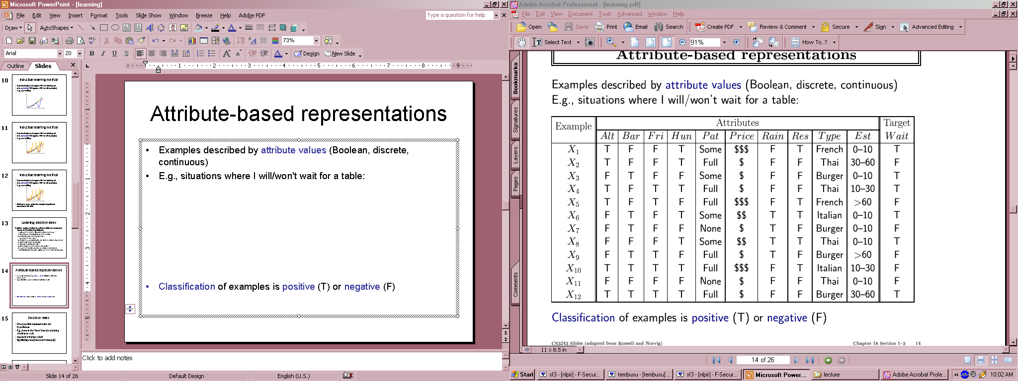
Attribute-based representations
Examples described by attribute values (Boolean, discrete, continuous)
E.g., situations where I will/won't wait for a table:
Classification of examples is positive (T) or negative (F)

Slide 13
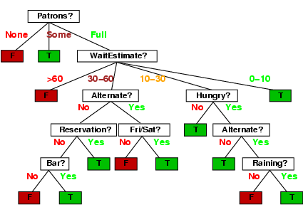
Decision trees
One possible representation for hypotheses
E.g., here is the “true” tree for deciding whether to wait:

Slide 14
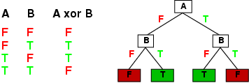
Expressiveness
Decision trees can express any function of the input attributes.
E.g., for Boolean functions, truth table row → path to leaf:
Trivially, there is a consistent decision tree for any training set with one path to leaf for each example (unless f nondeterministic in x)
but it probably won't generalize to new examples
Prefer to find more compact decision trees

Slide 15
Some specific applications include
◊ medical diagnosis,
◊ credit risk assessment of loan applications,
◊ equipment malfunctions by their cause,
◊ classification of plant diseases, and
◊ web search classification.

Slide 16
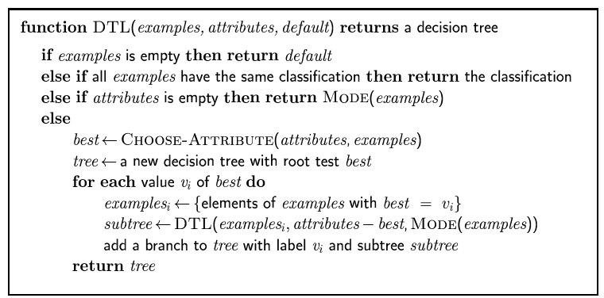
Decision tree learning
Aim: find a small tree consistent with the training examples
Idea: (recursively) choose "most significant" attribute as root of (sub)tree

Slide 17
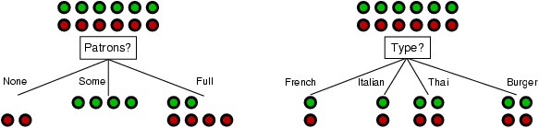
Choosing an attribute
Idea: a good attribute splits the examples into subsets that are (ideally) "all positive" or "all negative"
Patrons? is a better choice

Slide 18
Using information theory
To implement Choose-Attribute in the DTL algorithm
Information Content (Entropy):
I(P(v₁), … , P(v_{n})) = Σ_{i=1} -P(v_{i}) log₂ P(v_{i})
For a training set containing p positive examples and n negative examples:

Slide 19
Information gain
A chosen attribute A divides the training set E into subsets E₁, … , E_{v} according to their values for A, where A has v distinct values.
Information Gain (IG) or reduction in entropy from the attribute test:
Choose the attribute with the largest IG

Slide 20
Information gain
For the training set, p = n = 6, I(6/12, 6/12) = 1
Consider the attributes Patrons and Type (and others too):
Patrons has the highest IG of all attributes and so is chosen by the DTL algorithm as the root

Slide 21
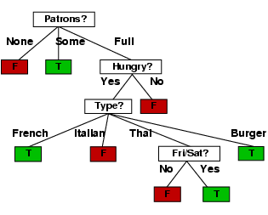
Example contd.
Decision tree learned from the 12 examples:
Substantially simpler than “true” tree---a more complex hypothesis isn’t justified by small amount of data

Slide 22
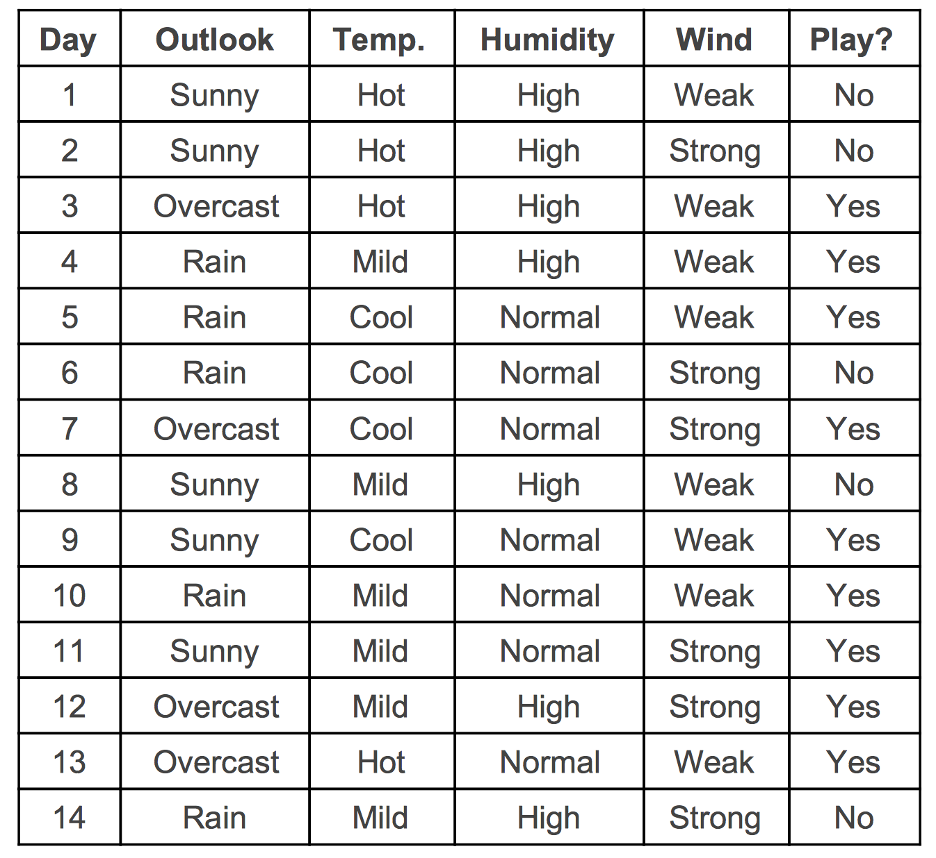
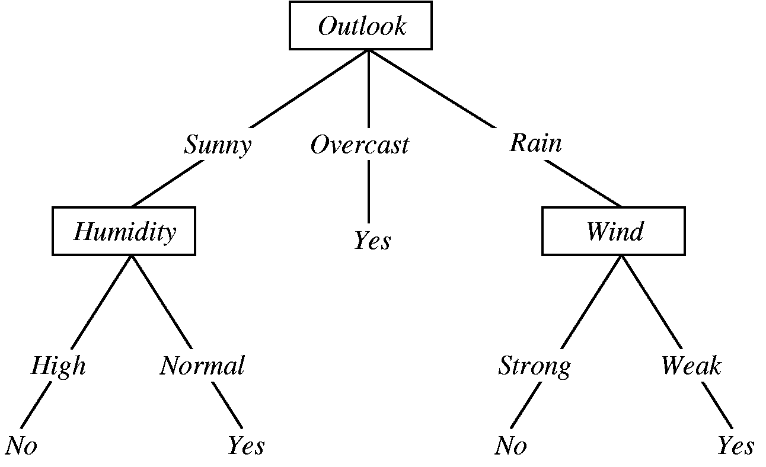
Decision Tree: An example

Slide 23
Decision Tree: An example

Slide 24
Decision Tree: An example

Slide 25
Decision Tree: An example

Slide 26
Decision Tree: An example

Slide 27
Decision Tree: An example

Slide 28
Decision Tree: An example

Slide 29
Decision Tree: An example

Slide 30
Decision Tree: An example

Slide 31
Decision Tree: An example

Slide 32
Summary
Learning needed for unknown environments, lazy designers
Learning agent = performance element + learning element
For supervised learning, the aim is to find a simple hypothesis approximately consistent with training examples
Decision tree learning using information gain
Learning performance = prediction accuracy measured on test set

Slide 33
Classification Trees
Classification trees are a hierarchical way of partitioning the space.
We start with the entire space and recursively divide it into smaller regions.
At the end, every region is assigned with a class label.
We start with a medical example to get a rough idea about classification trees.

Slide 34
Classification Trees (cont.)
One big advantage for decision trees is that the classifier generated is highly interpretable. For physicians, this is an especially desirable feature.
In this example, patients are classified into one of two classes: high risk versus low risk.
It is predicted that the high risk patients would not survive at least 30 days based on the initial 24-hour data.
There are 19 measurements taken from each patient during the first 24 hours. These include blood pressure, age, etc.

Slide 35
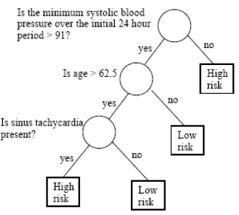
Classification Trees (cont.)
Here, we generate a tree-structured classification rule, which can be interpreted as follows:
Only three measurements are looked at by this classifier. For some patients, only one measurement determines the final result.
Classification trees operate similarly to a doctor's examination.

Slide 36
Classification Trees (cont.)
First we look at the minimum systolic blood pressure within the initial 24 hours and determine whether it is above 91.
If the answer is no, the patient is classified as high-risk. We don't need to look at the other measurements for this patient.
If the answer is yes, then we can't make a decision yet. The classifier will then look at whether the patient's age is greater than 62.5 years old.
If the answer is no, the patient is classified as low risk. However, if the patient is over 62.5 years old, we still cannot make a decision and then look at the third measurement, specifically, whether sinus tachycardia is present.
If the answer is no, the patient is classified as low risk. If the answer is yes, the patient is classified as high risk.

Slide 37
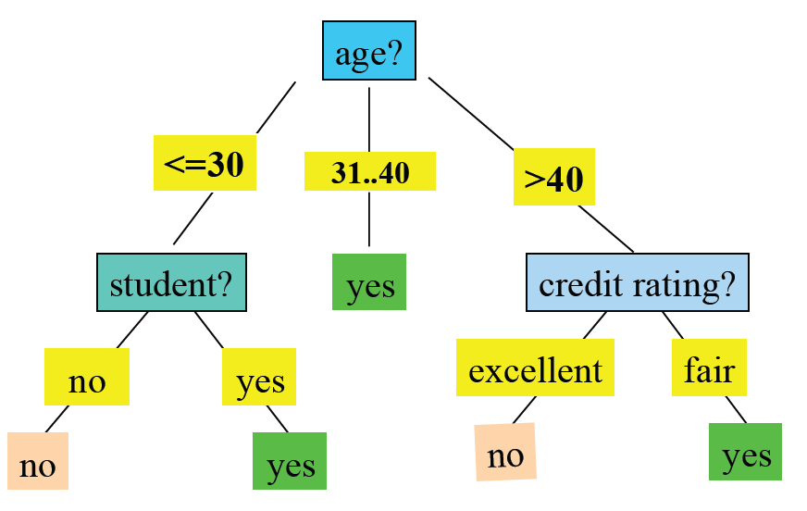
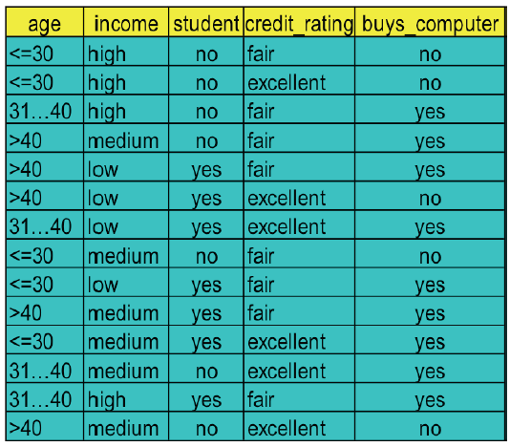
Classification Trees (cont.)
Business marketing: predict whether a person will buy a computer?

Slide 38
Classification Trees (cont.)
Notation:
We will denote the feature space by X. Normally X is a multidimensional Euclidean space.
However, sometimes some variables may be categorical such as gender (male or female).
Classification and Regression Trees (CART) have the advantage of treating real variables and categorical variables in a unified manner.
This is not so for many other classification methods, such as Linear Models.

Slide 39
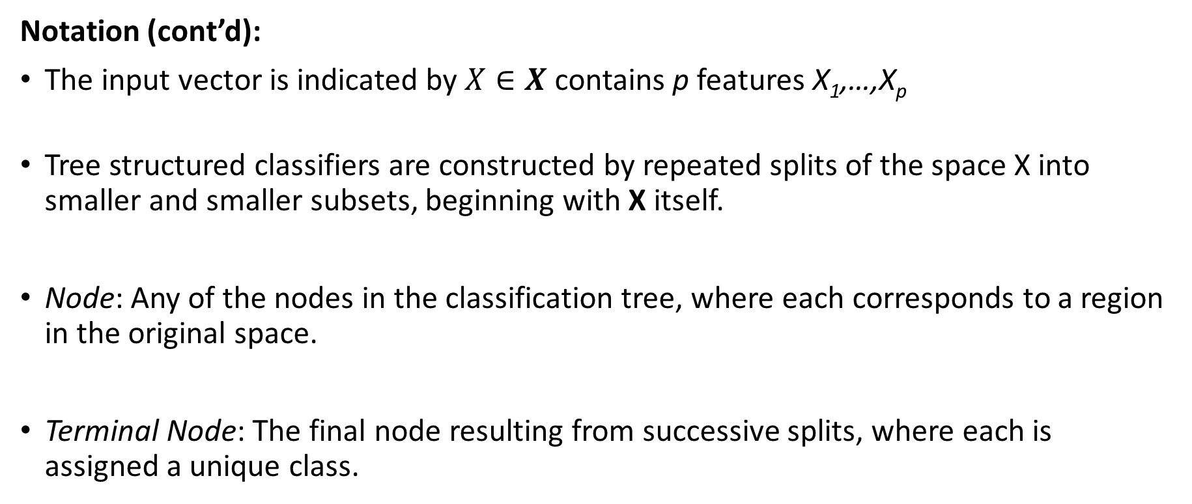
Classification Trees (cont.)
Notation (cont’d):
The input vector is indicated by $X∈X$contains p features X₁,…,X_{p}
Tree structured classifiers are constructed by repeated splits of the space X into smaller and smaller subsets, beginning with X itself.
Node: Any of the nodes in the classification tree, where each corresponds to a region in the original space.
Terminal Node: The final node resulting from successive splits, where each is assigned a unique class.

Slide 40
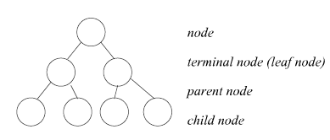
Classification Trees (cont.)
Notation (cont’d):
Parent Node: those nodes that are split into two child nodes.
Child Node: these result from the splitting of a parent node. Two child nodes are two different regions. Together they occupy the same region of the parent node.

Slide 41
Classification Trees (cont.)
Notation (cont’d):
One thing that we need to keep in mind is that the tree represents recursive splitting of the space.
Therefore, every node of interest corresponds to one region in the original space.
Two child nodes will occupy two different regions and if we put the two together, we get the same region as that of the parent node.
In the end, every leaf node is assigned with a class and a test point is assigned with the class of the leaf node it lands in.

Slide 42
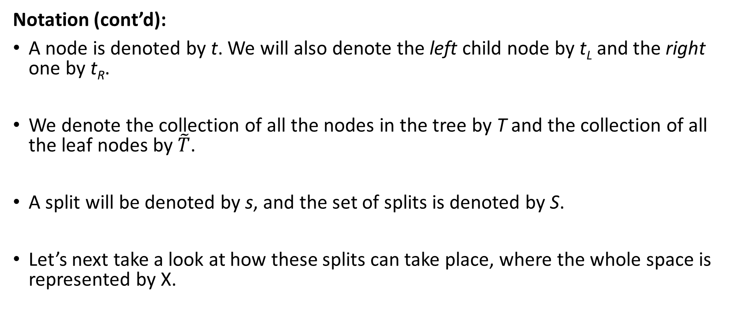
Classification Trees (cont.)
Notation (cont’d):
A node is denoted by t. We will also denote the left child node by t_{L} and the right one by t_{R}.
We denote the collection of all the nodes in the tree by T and the collection of all the leaf nodes by $\tilde{T}$.
A split will be denoted by s, and the set of splits is denoted by S.
Let’s next take a look at how these splits can take place, where the whole space is represented by X.

Slide 43
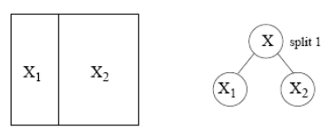
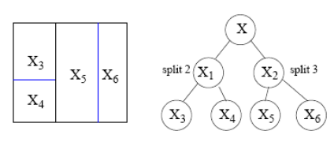
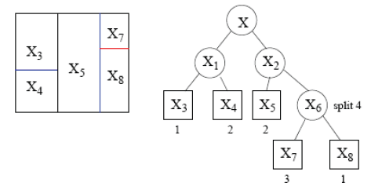
Classification Trees (cont.)

Slide 44
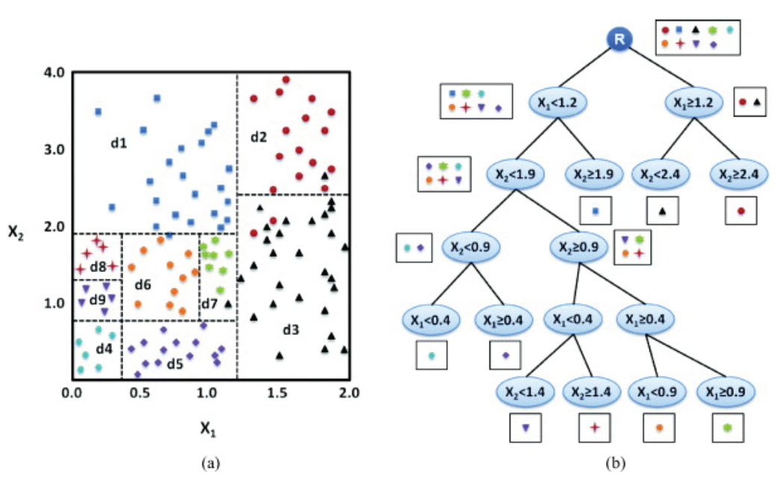
Classification Trees (cont.)

